Slide 1
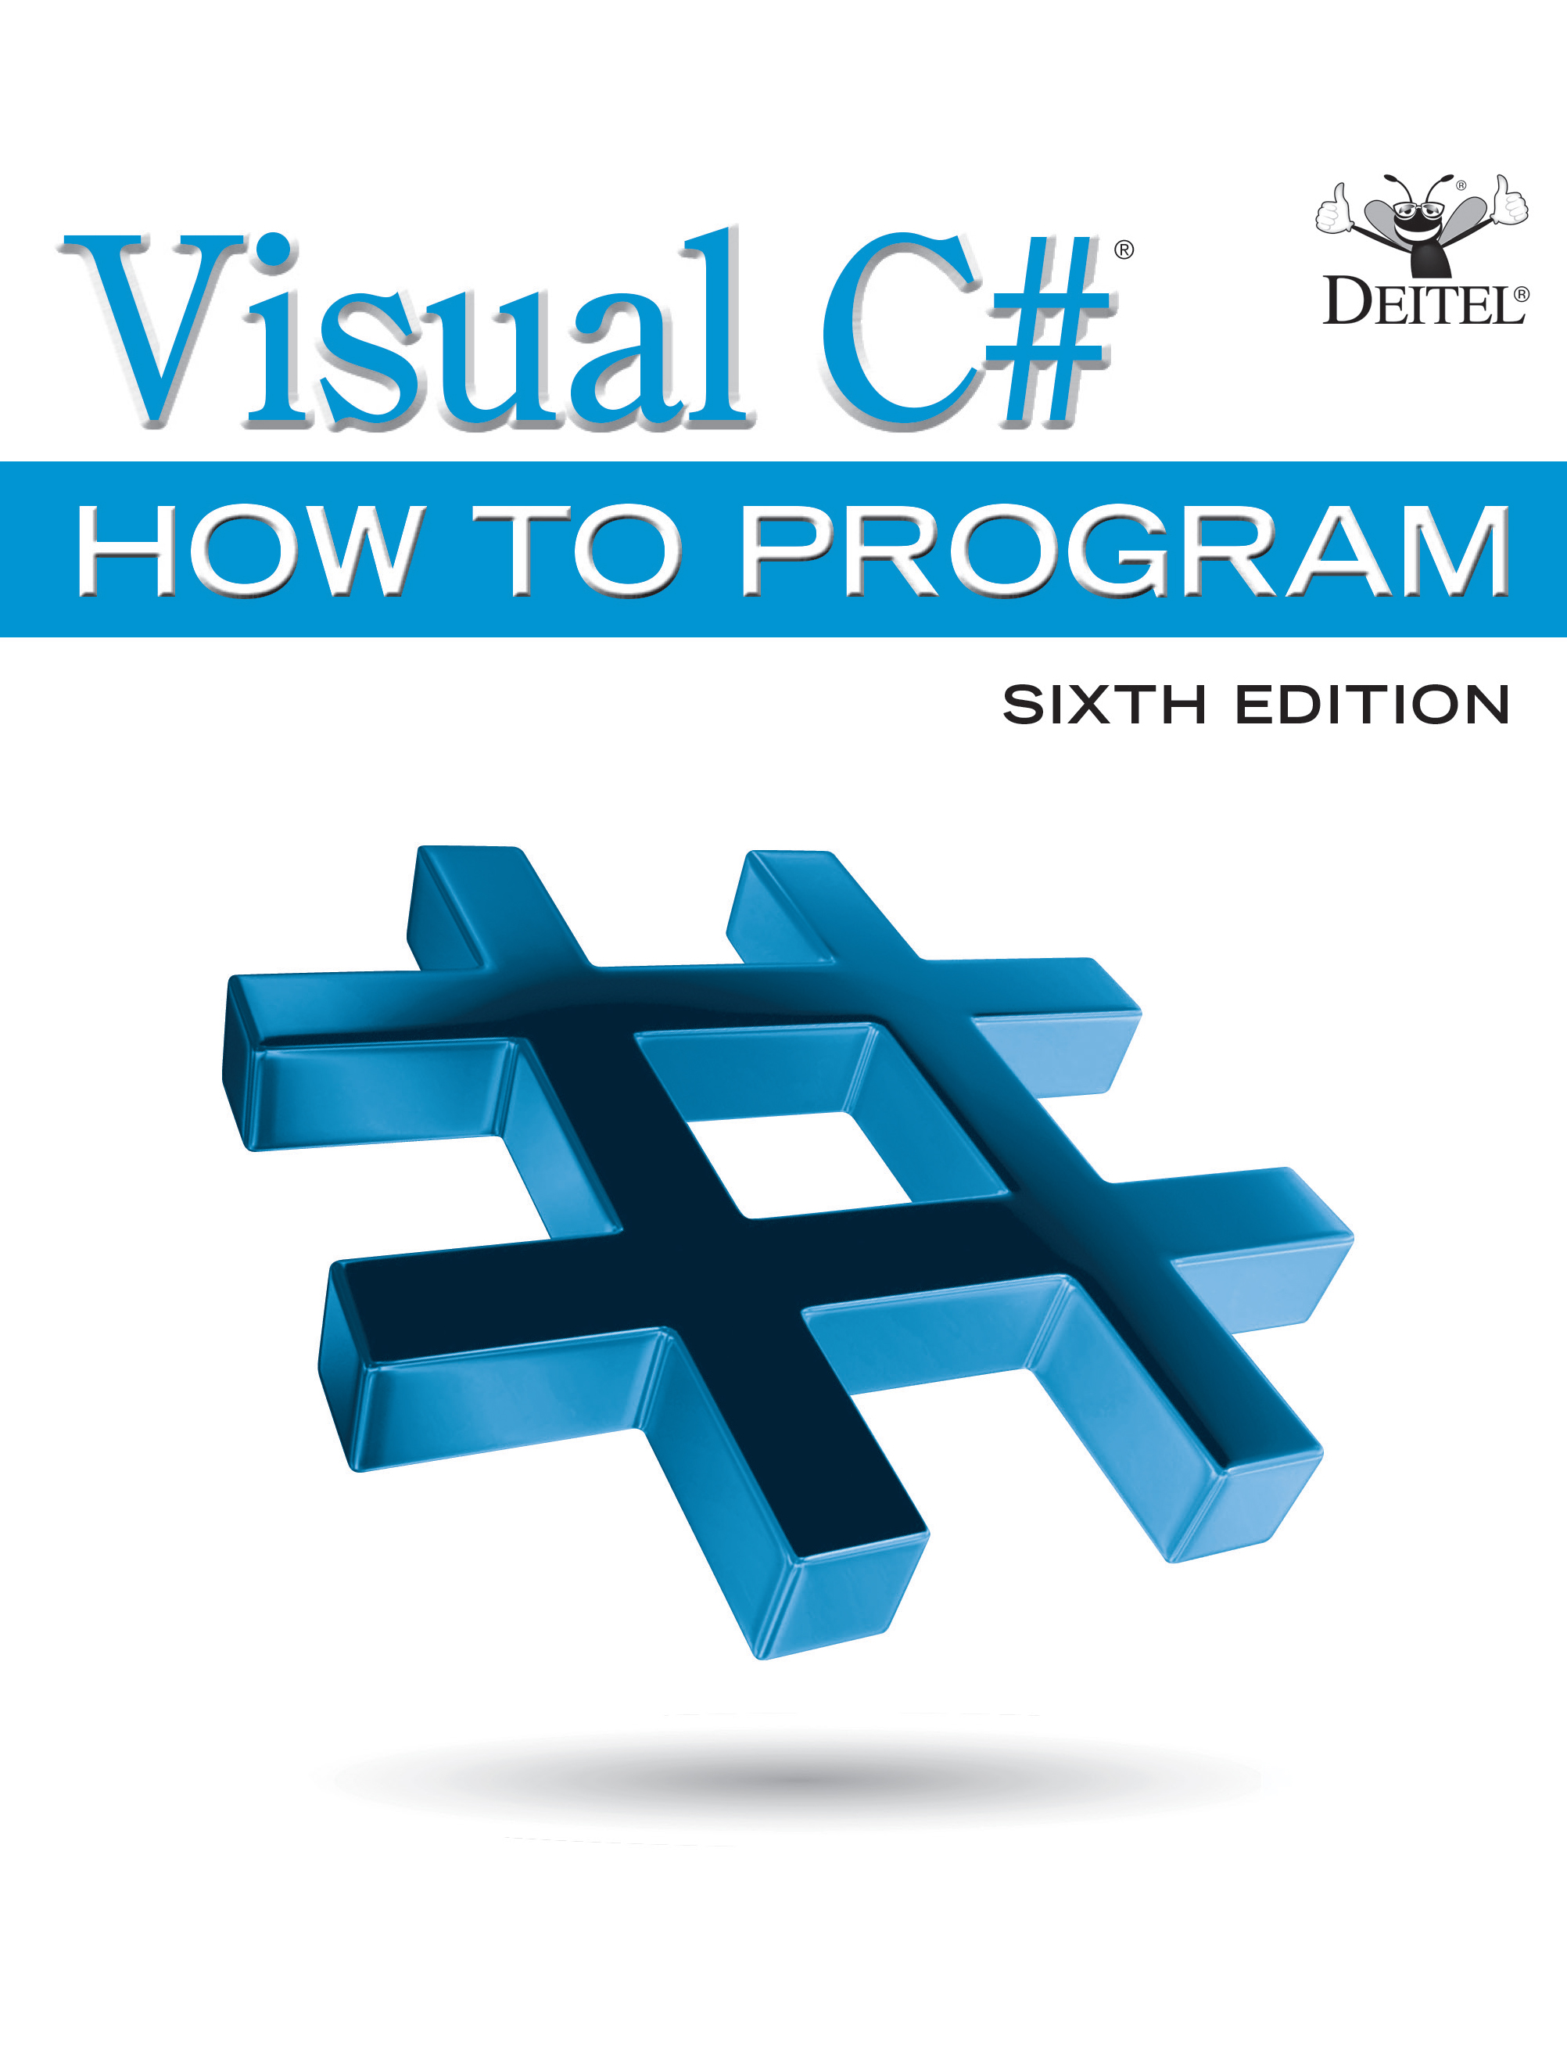
Visual C sharp® How to Program
Sixth Edition
Chapter 6
Control Statements: Part 2
Copyright © 2017 Pearson Education, Inc. All Rights Reserved
Notes:
If this PowerPoint presentation contains mathematical equations, you may need to check that your computer has the following installed:
1) MathType Plugin
2) Math Player (free versions available)
3) NVDA Reader (free versions available)

Slide 2
Learning Objectives (1 of 2)
Learn the essentials of counter-controlled iteration.
Use the for and do…while iteration statements to execute statements in a program repeatedly.
Understand multiple selection using the switch selection statement.
Use the break and continue program-control statements to alter the flow of control.

Slide 3
Learning Objectives (2 of 2)
Use the logical operators to form compound conditions in control statements.
Understand short-circuit evaluation of the conditional
Understand the representational errors associated with using floating-point data types to hold monetary values.
See a summary of structured programming and
control statements

Slide 4
Outline (1 of 5)
6.1 Introduction
6.2 Essentials of Counter-Controlled Iteration
6.3 for Iteration Statement
6.3.1 A Closer Look at the for Statement’s Header
6.3.2 General Format of a for Statement
6.3.3 Scope of a for Statement’s Control Variable
6.3.4 Expressions in a for Statement’s Header Are Optional
6.3.5 Placing Arithmetic Expressions in a for Statement’s Header

Slide 5
Outline (2 of 5)
6.3.6 Using a for Statement’s Control Variable in the Statement’s Body
6.3.7 U M L Activity Diagram for the for Statement
6.4 Examples Using the for Statement
6.5 App: Summing Even Integers
6.6 App: Compound-Interest Calculations
6.6.1 Performing the Interest Calculation with Math Method pow
6.6.2 Formatting with Field Widths and Alignment

Slide 6
Outline (3 of 5)
6.6.3 Caution: Do Not Use float or double for Monetary Amounts
6.7 do…while Iteration Statement
6.8 switch Multiple-Selection Statement
6.8.1 Using a switch Statement to Count A, B, C, D and F Grades
6.8.2 switch Statement U M L Activity Diagram
6.8.3 Notes on the Expression in Each case of a switch

Slide 7
Outline (4 of 5)
6.9 Class AutoPolicy Case Study: strings in switch Statements
6.10 break and continue Statements
6.10.1 break Statement
6.10.2 continue Statement
6.11 Logical Operators
6.11.1 Conditional
6.11.2 Conditional
6.11.3 Short-Circuit Evaluation of Complex Conditions

Slide 8
Outline (5 of 5)
6.11.4 Boolean Logical
and Boolean Logical
6.11.5 Boolean Logical Exclusive
6.11.6 Logical Negation
6.11.7 Logical Operators Example
6.12 Structured-Programming Summary
6.13 Wrap-Up

Slide 9
6.2 Essentials of Counter-Controlled Iteration
Counter-controlled iteration requires
a control variable (or loop counter)
the initial value of the control variable
the increment (or decrement) by which the control variable is modified each iteration of the loop
the loop-continuation condition
Figure 6.1 uses a loop to display the numbers from 1 through 10.

Slide 10
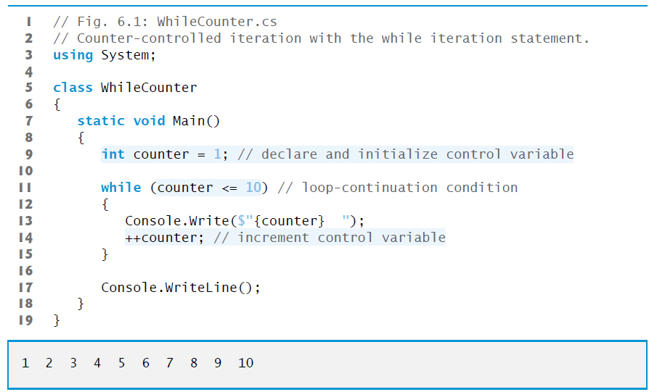
Figure 6.1 Counter-Controlled Iteration with the while Iteration Statement

Slide 11
Error-Prevention Tip 6.1
Floating-point values are approximate, so controlling counting loops with floating-point variables of types float or double can result in imprecise counter values and inaccurate tests for termination. Use integer values to control counting loops.

Slide 12
6.3 for Iteration Statement (1 of 5)
The for iteration statement specifies the elements of counter-controlled-iteration in a single line of code.
Figure 6.2 reimplements the app using the for statement.

Slide 13
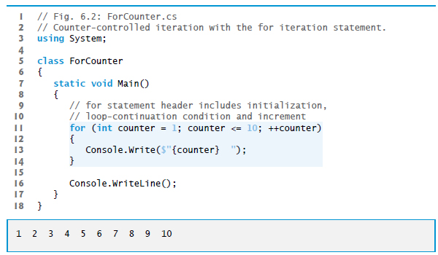
Figure 6.2 Counter-Controlled Iteration with the for Iteration Statement

Slide 14
Common Programming Error 6.1
Using an incorrect relational operator or an incorrect final value of a loop counter in the loop-continuation condition of an iteration statement can cause an off-by-one error.

Slide 15
Error-Prevention Tip 6.2
in a loop’s condition helps avoid off-by-one errors. For a loop that outputs 1 to 10, the loop-continuation condition should be
Using the final value and operator
rather than counter < 10 (which causes an off-by-one error) or counter < 11 (which is correct). Many programmers prefer zero-based counting in which, to count 10 times, you’d initialize counter to zero and use the loop-continuation test counter < 10.

Slide 16
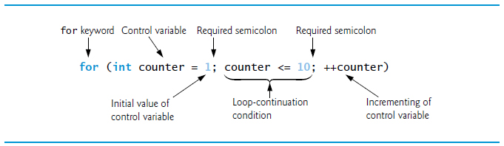
Figure 6.3 for Statement Header Components

Slide 17
6.3 for Iteration Statement (2 of 5)
If the initialization expression declares the control variable, the control variable will not exist outside the for statement.
This restriction is known as the variable’s scope.
Similarly, a local variable can be used only in the method that declares the variable and only from the point of declaration.

Slide 18
Common Programming Error 6.2
When a for statement’s control variable is declared in the initialization section of a for’s header, using the control variable after the for’s body is a compilation error.

Slide 19
6.3 for Iteration Statement (3 of 5)
All three expressions in a for header are optional.
Omitting the loop Continuation Condition creates an infinite loop.
You can omit the initialization expression if the control variable is initialized before the loop.
You can omit the increment expression if the app calculates the increment with statements in the loop’s body or if no increment is needed.

Slide 20
Performance Tip 6.1
There’s a slight performance advantage to using the prefix increment operator, but if you choose the postfix increment operator because it seems more natural (as in a for header), optimizing compilers are likely to generate code that uses the more efficient form anyway.

Slide 21
Error-Prevention Tip 6.3
Infinite loops occur when the loop-continuation condition in an iteration statement never becomes false. To prevent this situation in a counter-controlled loop, ensure that the control variable is incremented (or decremented) during each iteration of the loop. In a sentinel-controlled loop, ensure that the sentinel value is eventually entered.

Slide 22
6.3 for Iteration Statement (4 of 5)
The initialization, loop-continuation condition and increment portions of a for statement can contain arithmetic expressions.
For example, assume that x = 2 and y = 10; if x and y are not modified in the body of the loop, then the statement
is equivalent to the statement
If the loop-continuation condition is initially false, the app does not execute the for statement’s body.

Slide 23
Error-Prevention Tip 6.4
Although the value of the control variable can be changed in the body of a for loop, avoid doing so, because this practice can lead to subtle errors. If a program must modify the control variable’s value in the loop’s body, use while rather than for.

Slide 24
6.3 for Iteration Statement (5 of 5)
Figure 6.4 shows the activity diagram of the for statement in Figure 6.2.

Slide 25
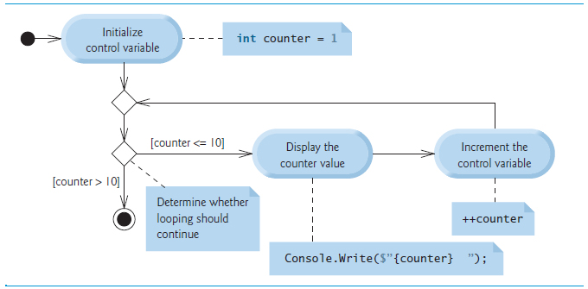
Figure 6.4 U M L Activity Diagram for the for Statement in Figure 6.2

Slide 26
Common Programming Error 6.3
Using an incorrect relational operator in the loop-continuation condition of a loop that counts downward (e.g., using
in a loop counting down to 1) is usually a logic error.

Slide 27
Common Programming Error 6.4
in a loop-continuation condition if the loop’s control variable increments or decrements by more than 1. For example, consider the for statement header
Do not use equality operators
The loop-continuation test
never becomes false (resulting in an infinite loop) because counter increments by 2 after each iteration (and never becomes 10).

Slide 28
6.5 App: Summing Even Integers (1 of 2)
The app in Figure 6.5 uses a for statement to sum the even integers from 2 to 20 and store the result in an int variable called total.

Slide 29
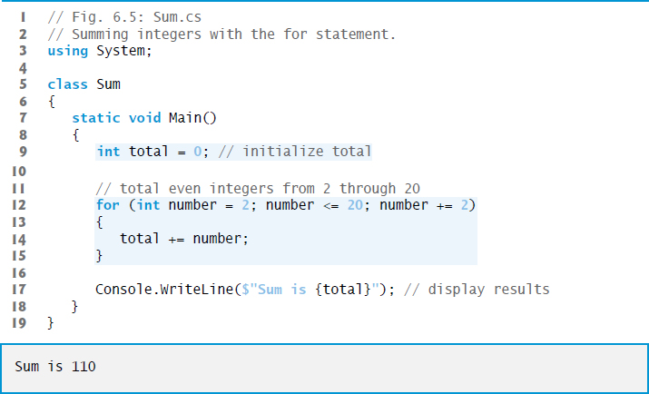
Figure 6.5 Summing Integers with the for Statement

Slide 30
6.5 App: Summing Even Integers (2 of 2)
The initialization and increment expressions can be comma-separated lists that enable you to use multiple initialization expressions or multiple increment expressions.
For example, although this is discouraged, you could merge the for’s body statement (line 14) into the increment portion of the for header by using a comma as follows:

Slide 31
6.6 App: Compound-Interest Calculations
A person invests $1,000 in a savings account yielding 5% interest, compounded yearly. Calculate and display the amount of money in the account at the end of each year for 10 years.
p is the original amount invested (i.e., the principal) r is the annual interest rate (use 0.05 for 5%) n is the number of years a is the amount on deposit at the end of the nth year.
Figure 6.6 uses a loop that performs the calculation for each of the 10 years the money remains on deposit.

Slide 32
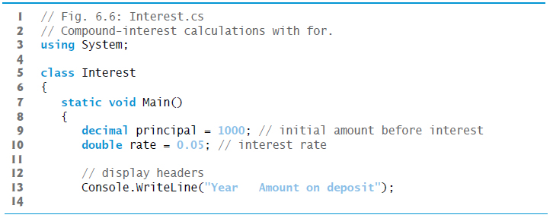
Figure 6.6 Compound-Interest Calculations with for (1 of 3)

Slide 33
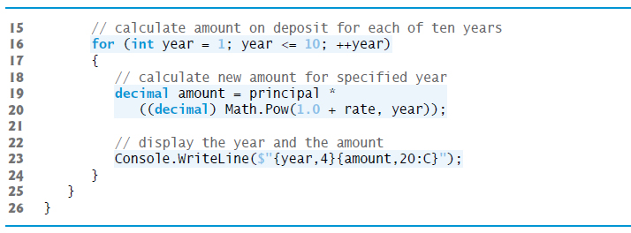
Figure 6.6 Compound-Interest Calculations with for (2 of 3)

Slide 34
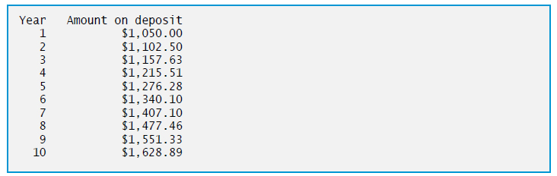
Figure 6.6 Compound-Interest Calculations with for (3 of 3)

Slide 35
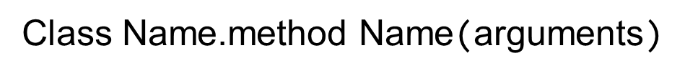
6.6.1 Performing the Interest Calculations with Math Method pow
Many classes provide static methods that cannot be called on objects—they must be called using a class name.
You can call a static method by specifying the class name followed by the member access (·) operator and the method name:
calculates the value of x raised to the yth power.

Slide 36
Performance Tip 6.2
In loops, avoid calculations for which the result never changes—such calculations should typically be placed before the loop. Optimizing compilers will typically do this for you.

Slide 37
6.6.2 Formatting with Field Widths and Alignment
displays the year and the amount on deposit at the end of that year.
The interpolation expression
{year,4}
formats the year.
The integer 4 after the comma indicates that the value output should be displayed with a field width of 4.
If the value to be output is fewer than four character positions wide (one or two characters in this example), the value is right-aligned in the field by default.
If the value to be output were more than four character positions wide, the field width would be extended to the right to accommodate the entire value.

Slide 38
Common Programming Error 6.5
Using floating-point numbers in a manner that assumes they’re represented exactly (e.g., using them in comparisons for equality) can lead to incorrect results. Floating-point numbers are represented only approximately.

Slide 39
6.6.3 Caution: Do Not Use float or double for Monetary Amounts
Section 4.9 introduced the simple type decimal for precise monetary representation and calculations.
For certain values types float and double suffer from what we call representational error.
Floating-point numbers often arise as a result of calculations—when we divide 10 by 3, the result is 3.3333333…, with the sequence of 3s repeating infinitely.
The computer allocates only a fixed amount of space to hold such a value, so clearly the stored floating-point value can be only an approximation.

Slide 40
Error-Prevention Tip 6.5
Do not use variables of type double (or float) to perform precise monetary calculations—use type decimal instead. The imprecision of floating-point numbers can cause errors that will result in incorrect monetary values.

Slide 41
6.7 do...while Iteration Statement (1 of 2)
The do…while iteration statement (Figure 6.7) is similar to the while statement.

Slide 42
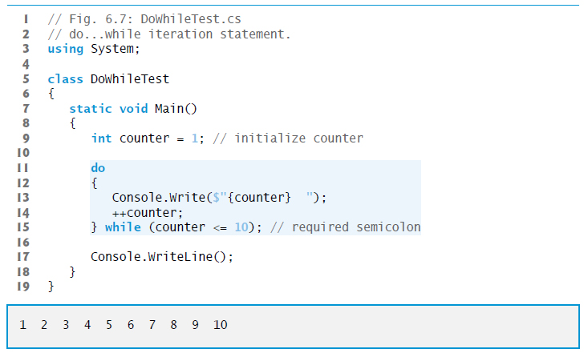
Figure 6.7 do...while Iteration Statement

Slide 43
6.7 do...while Iteration Statement (2 of 2)
Figure 6.8 contains the U M L activity diagram for the do...while statement.

Slide 44
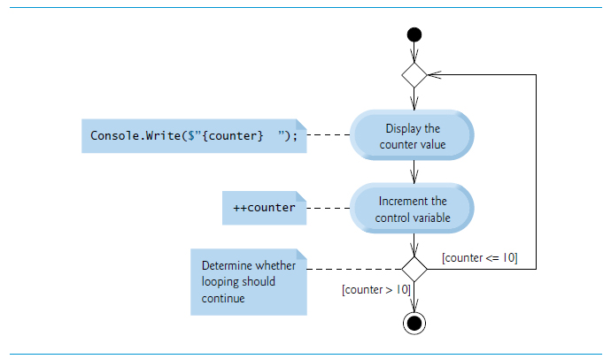
Figure 6.8 do…while Iteration Statement U M L Activity Diagram

Slide 45
6.8 switch Multiple-Selection Statement
The switch multiple-selection statement performs different actions based on the value of an expression.
Each action is associated with the value of a constant integral expression or a constant string expression that the expression may assume.

Slide 46
6.8.1 Using a switch Statement to Count A, B, C, D and F Grades (1 of 2)
Figure 6.9 calculates the class average of a set of numeric grades entered by the user, and uses a switch statement to determine whether each grade is the equivalent of an A, B, C, D or F and to increment the appropriate grade counter.
The program also displays a summary of the number of students who received each grade.

Slide 47
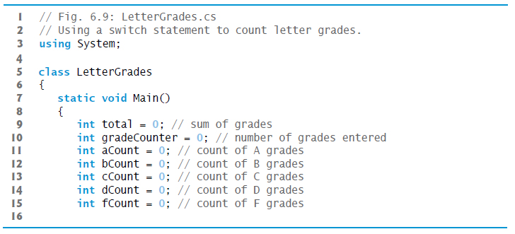
Figure 6.9 Using a switch Statement to Count Letter Grades (1 of 6)

Slide 48
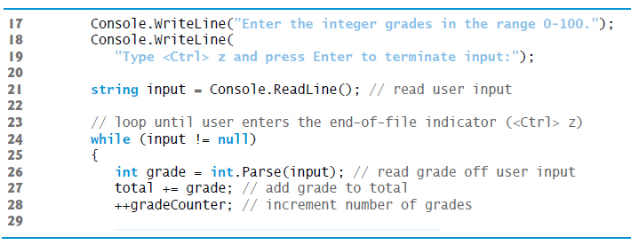
Figure 6.9 Using a switch Statement to Count Letter Grades (2 of 6)

Slide 49
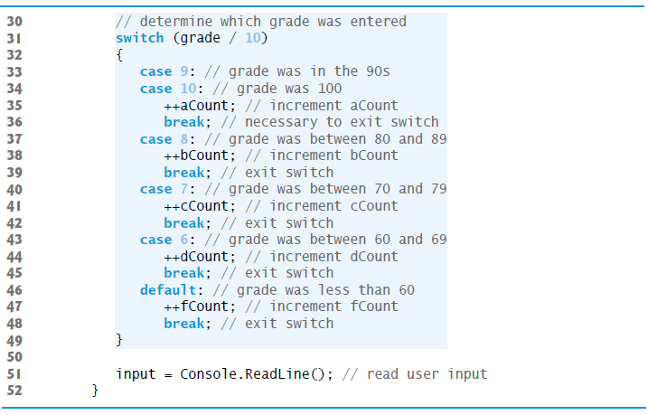
Figure 6.9 Using a switch Statement to Count Letter Grades (3 of 6)

Slide 50
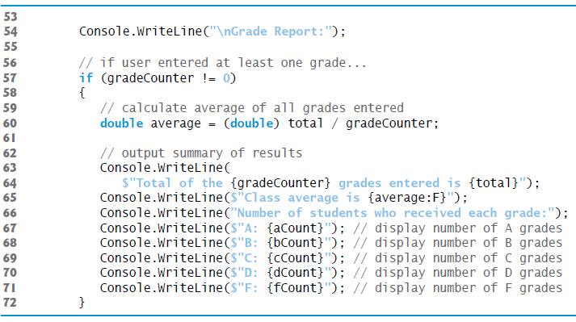
Figure 6.9 Using a switch Statement to Count Letter Grades (4 of 6)

Slide 51
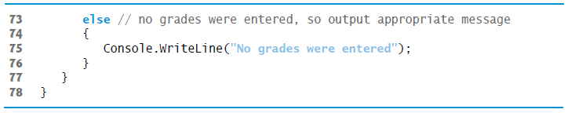
Figure 6.9 Using a switch Statement to Count Letter Grades (5 of 6)

Slide 52
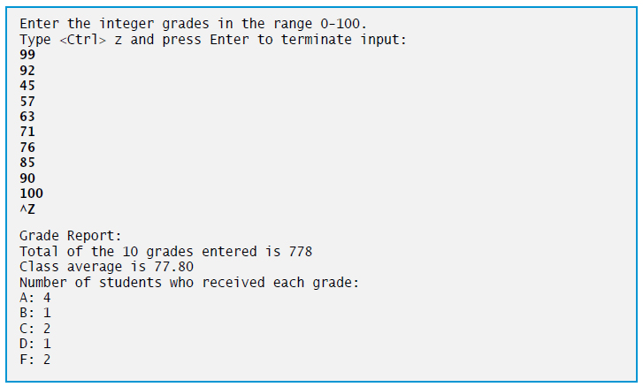
Figure 6.9 Using a switch Statement to Count Letter Grades (6 of 6)

Slide 53
6.8.1 Using a switch Statement to Count A, B, C, D and F Grades (2 of 2)
The expression following keyword switch is called the switch expression.
The app attempts to match the value of the switch expression with one of the case labels.
You are required to include a statement that terminates the case, such as a break, a return or a throw.
The break statement causes program control to proceed with the first statement after the switch.
If no match occurs, the statements after the default label execute.

Slide 54
Good Programming Practice 6.1
Although each case and the default label in a switch can occur in any order, place the default label last for clarity.

Slide 55
6.8.2 switch Statement U M L Activity Diagram
Figure 6.11(see slide 61) shows the U M L activity diagram for the general switch statement.

Slide 56
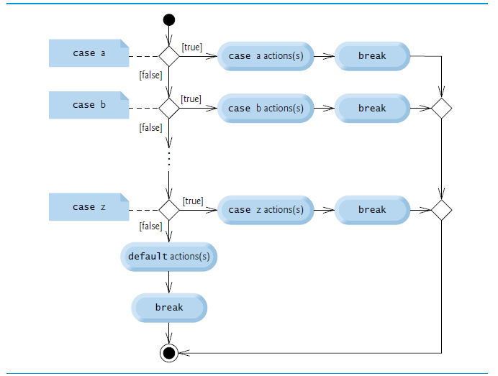
Figure 6.10 switch Multiple-Selection Statement U M L Activity Diagram with break Statements

Slide 57
6.8.3 Notes on the Expression in Each case of a switch
The expression after each case can be only a constant integral expression or a constant string expression.
You can also use null and character constants which represent the integer values of characters.
The expression also can be a constant that contains a value which does not change for the entire app.

Slide 58
6.9 Class AutoPolicy Case Study: strings in switch Statements
strings can be used in switch expressions, and string literals can be used in case labels.
You’ve been hired by an auto insurance company that serves these northeast states—Connecticut, Maine, Massachusetts, New Hampshire, New Jersey, New York, Pennsylvania, Rhode Island and Vermont. The company would like you to create a program that produces a report indicating for each of their auto insurance policies whether the policy is held in a state with “no-fault” auto insurance—Massachusetts, New Jersey, New York and Pennsylvania.

Slide 59
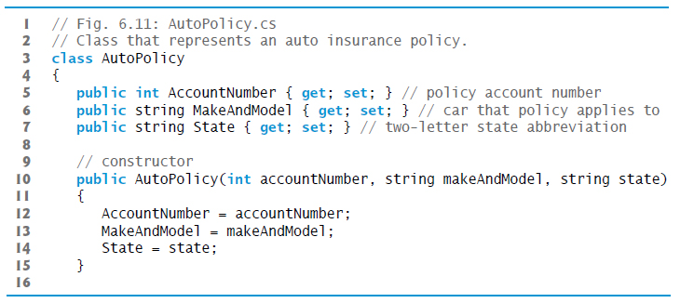
Figure 6.11 Class That Represents an Auto Insurance Policy (1 of 2)

Slide 60
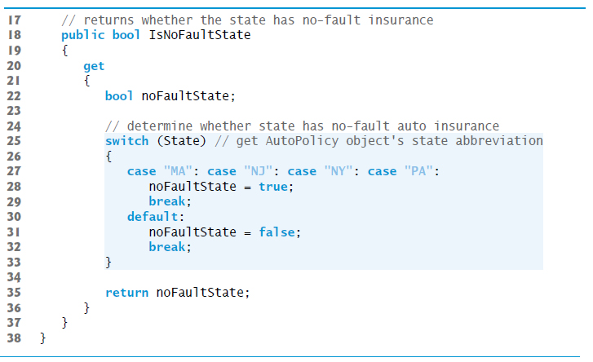
Figure 6.11 Class That Represents an Auto Insurance Policy (2 of 2)

Slide 61
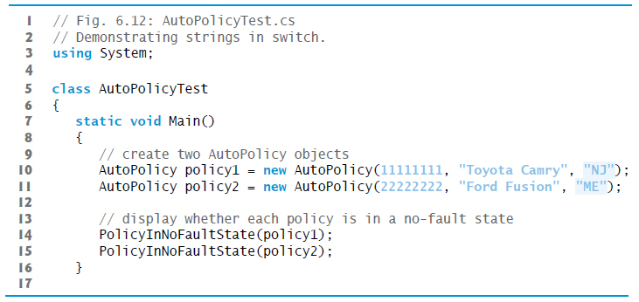
Figure 6.12 Demonstrating strings in switch (1 of 2)

Slide 62
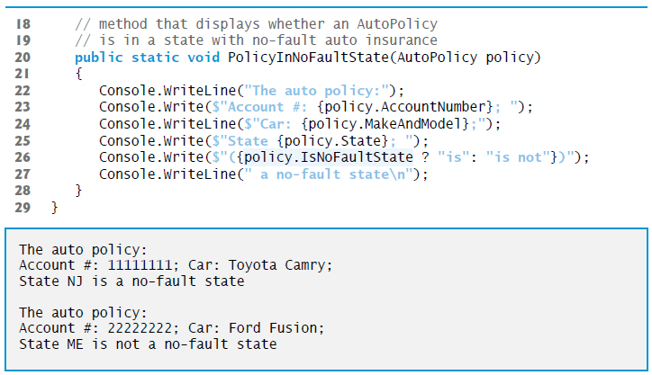
Figure 6.12 Demonstrating strings in switch (2 of 2)

Slide 63
6.10.1 break Statement
The break statement causes immediate exit from a statement.
Figure 6.13 demonstrates a break statement exiting a for.

Slide 64
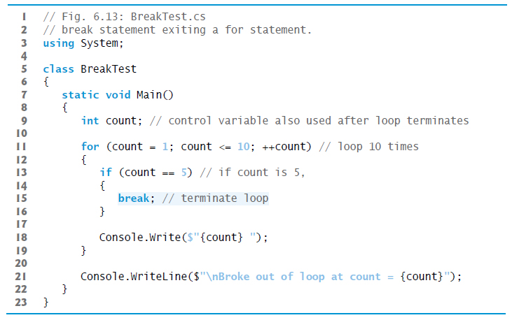
Figure 6.13 break Statement Exiting a for Statement (1 of 2)

Slide 65
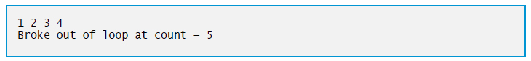
Figure 6.13 break Statement Exiting a for Statement (2 of 2)

Slide 66
6.10.2 break Statement
The continue statement skips the remaining statements in the loop body and tests whether to proceed with the next iteration of the loop.
In a for statement, the increment expression executes, then the app evaluates the loop-continuation test.
Figure 6.14 (see slide 71) uses continue in a for statement.

Slide 67
Software Engineering Observation 6.1
Some programmers feel that break and continue statements violate structured programming. Since the same effects are achievable with structured-programming techniques, these programmers prefer not to use break or continue statements.

Slide 68
Software Engineering Observation 6.2
There’s a tension between achieving quality software engineering and achieving the best-performing software. Often, one of these goals is achieved at the expense of the other. For all but the most performance-intensive situations, apply the following rule: First, make your code simple and correct; then make it fast, but only if necessary.

Slide 69
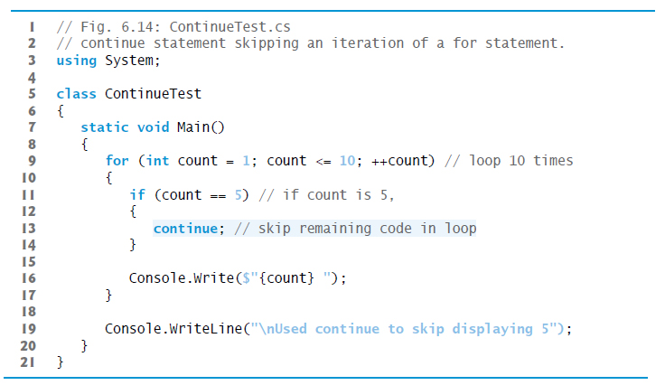
Figure 6.14 continue Statement Skipping an Iteration of a for Statement (1 of 2)

Slide 70
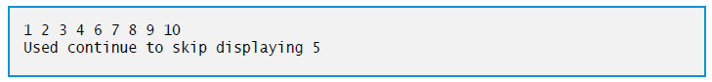
Figure 6.14 continue Statement Skipping an Iteration of a for Statement (2 of 2)

Slide 71
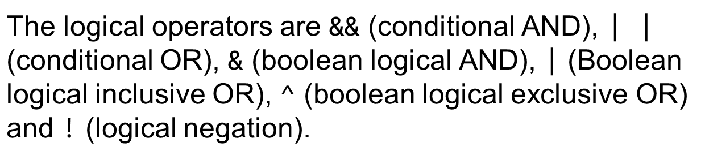
6.11 Logical Operators
Simple conditions are expressed in terms of the relational operators >, <,
and the equality operators
Each expression tests only one condition.
provides logical operators to enable you to form more complex conditions by combining simple conditions.

Slide 72
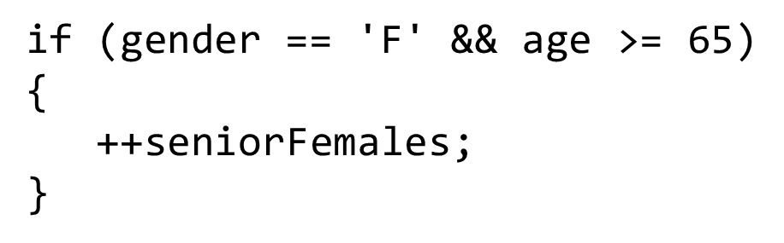
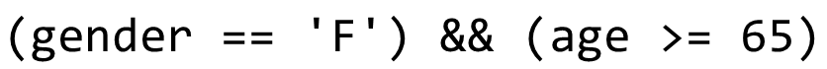
6.11.1 Conditional AND(Ampersand ampersand Operator (1 of 2)
The && (conditional AND) operator works as follows:
The combined condition is true if and only if both simple conditions are true.
The combined condition may be more readable with redundant parentheses:

Slide 73
6.11.1 Conditional AND(Ampersand ampersand Operator (2 of 2)
The table in Figure 6.15 shows all four possible combinations of false and true values for expression1 and expression2.
Such tables are called truth tables.

Slide 74
Figure 6.15 mpersand ampersand (Conditional AND) Operator Truth Table
expression1 | expression2 | expression1 Ampersand ampersand expression2
false | false | false
false | true | false
true | false | false
true | true | true

Slide 75
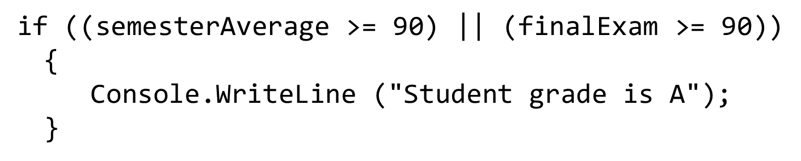
6.11.2 Conditional OR Double pipe Operator
(conditional OR) operator, as in the following app segment:
The
The complex condition evaluates to true if either or both of the simple conditions are true.
Figure 6.16 is a truth table for operator conditional OR

Slide 76
Figure 6.16 Double pipe (Conditional or) Operator Truth Table
expression1 | expression2 | expression1 Double pipe expression2
false | false | false
false | true | true
true | false | true
true | true | true

Slide 77
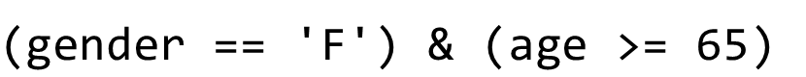
6.11.3 Short-Circuit Evaluation of Complex Conditions
The parts of an expression containing
are evaluated only until it’s known whether the condition is true or false.
If gender is not equal to 'F' (i.e., it is certain that the entire expression is false) evaluation stops.
This feature is called short-circuit evaluation.

Slide 78
Common Programming Error 6.6
a condition—known as the dependent condition—may require another condition to be true for the evaluation of the dependent condition to be meaningful. In this case, the dependent condition should be placed after the other one, or an error might occur. For example, in the expression
In expressions using operator
the second condition must appear after the first condition, or a divide-by-zero error might occur.

Slide 79
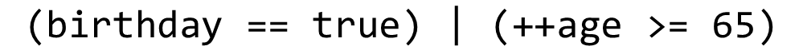
6.11.4 Boolean Logical AND Ampersand and Boolean Logical OR Pipe Operators
and boolean logical inclusive OR
The boolean logical AND
operators do not perform short-circuit evaluation.
This is useful if the right operand has a required side effect. For example:
will be evaluated.
This ensures that the condition

Slide 80
Error-Prevention Tip 6.6
For clarity, avoid expressions with side effects in conditions. The side effects may appear clever, but they can make it harder to understand code and can lead to subtle logic errors.

Slide 81
6.11.5 Boolean Logical Exclusive OR (^)
A complex condition containing the boolean logical exclusive OR
operator (also called the logical XOR operator) is true if and only if one of its operands is true and the other is false.
Figure 6.17 is a truth table for the boolean logical exclusive OR operator

Slide 82
Figure 6.17 Caret (Boolean Logical Exclusive OR) Operator Truth Table
expression1 | expression2 | expression1 Caret expression2
false | false | false
false | true | true
true | false | true
true | true | false

Slide 83
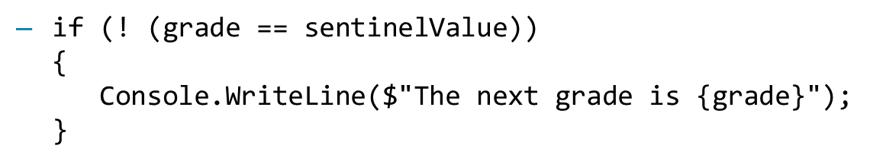

6.11.6 Logical Negation Exclamation point Operator
The
(logical negation or not) operator enables you to “reverse” the meaning of a condition.
In most cases, you can avoid using logical negation by expressing the condition differently:
Figure 6.18 is a truth table for the logical negation operator.

Slide 84
Figure 6.18 Exclamation point (Logical Negation) Operator Truth Table
expression | Exclamation point expression
false | true
true | false

Slide 85
6.11.7 Logical Operators Example (1 of 2)
Figure 6.19 demonstrates the logical operators and boolean logical operators.

Slide 86
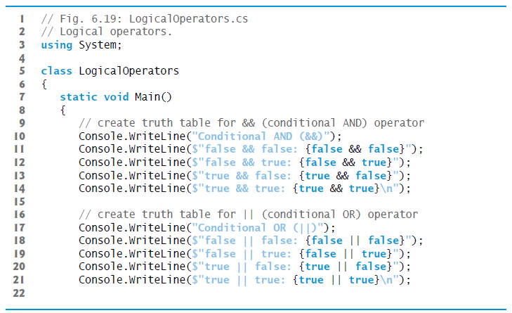
Figure 6.19 Logical Operators (1 of 5)

Slide 87
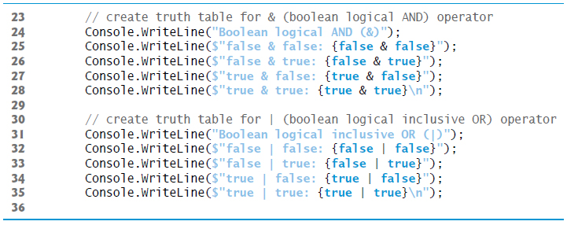
Figure 6.19 Logical Operators (2 of 5)

Slide 88
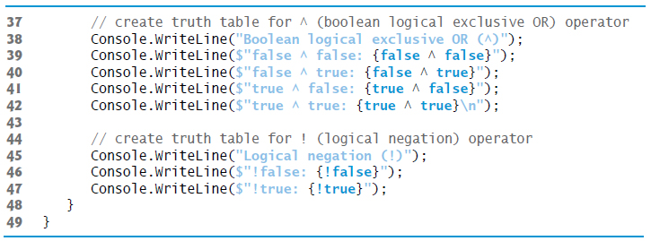
Figure 6.19 Logical Operators (3 of 5)

Slide 89
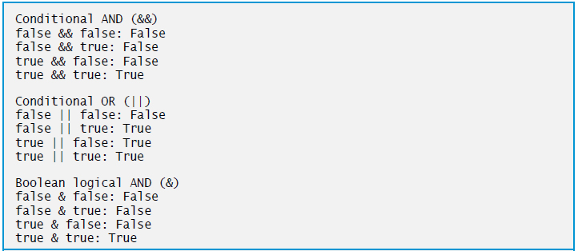
Figure 6.19 Logical Operators (4 of 5)

Slide 90
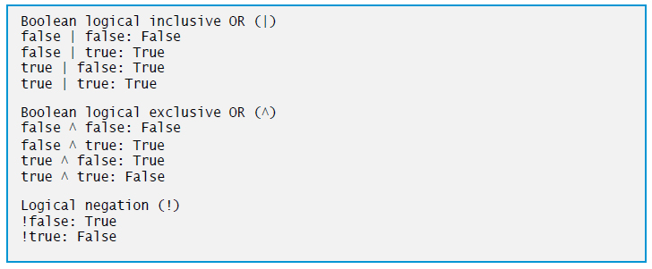
Figure 6.19 Logical Operators (5 of 5)

Slide 91
6.11.7 Logical Operators Example (2 of 2)
operators from highest precedence to lowest.
Figure 6.20 shows the

Slide 92
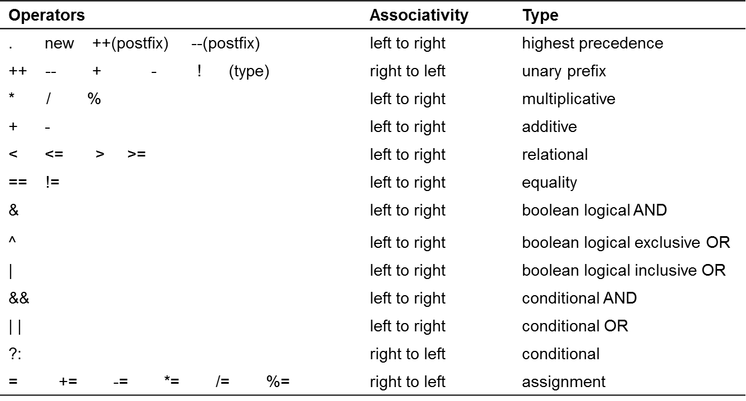
Figure 6.20 Precedence/Associativity of the Operators Discussed So Far

Slide 93
6.12 Structured-Programming Summary (1 of 5)
Structured programming produces apps that are easier to understand, test, debug, and modify.
The final state of one control statement is connected to the initial state of the next (Figure 6.21). We call this “control-statement stacking.”

Slide 94
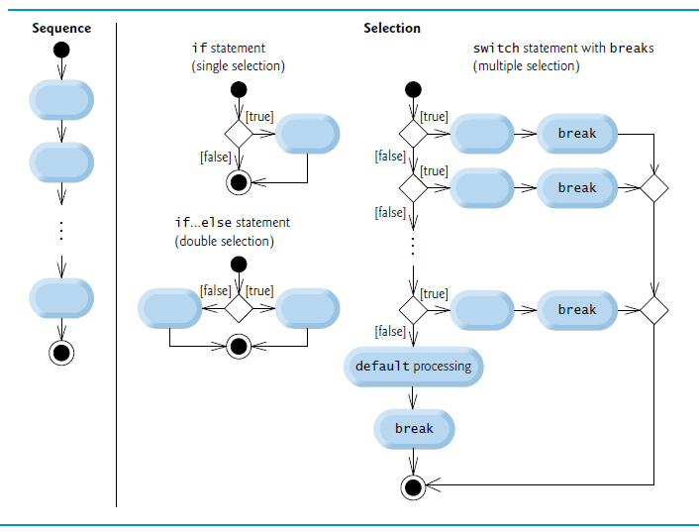
Figure 6.21 C sharp’s Sequence, Selection and Iteration Statements (1 of 2)

Slide 95
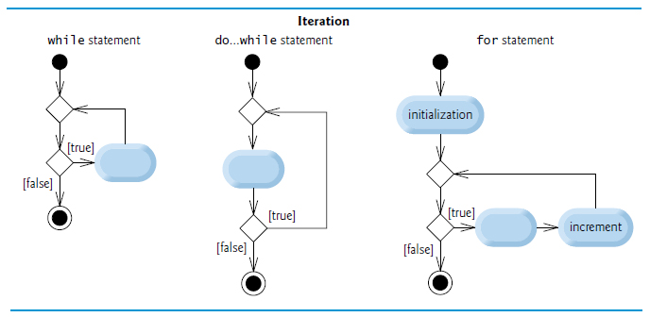
Figure 6.21 C sharp’s Sequence, Selection and Iteration Statements (2 of 2)

Slide 96
Figure 6.22 Rules for Forming Structured Apps
Rules for forming structured apps
Begin with the simplest activity diagram (Figure 6.23(see slide 100)).
Any action state can be replaced by two action states in sequence.
Any action state can be replaced by any control statement (sequence of action states, if, if…else, switch, while, do…while, for or foreach, which we’ll see in Chapter 8).
Rules 2 and 3 can be applied as often as necessary in any order.

Slide 97
6.12 Structured-Programming Summary (2 of 5)
We begin with the simplest activity diagram (Figure 6.23) consisting of only an initial state, an action state, a final state and transition arrows.

Slide 98

Figure 6.23 Simplest Activity Diagram

Slide 99
6.12 Structured-Programming Summary (3 of 5)
Rule 2 generates a stack of control statements, so let us call rule 2 the stacking rule.
Repeatedly applying rule 2 results in an activity diagram containing many action states in sequence (Figure 6.24).

Slide 100
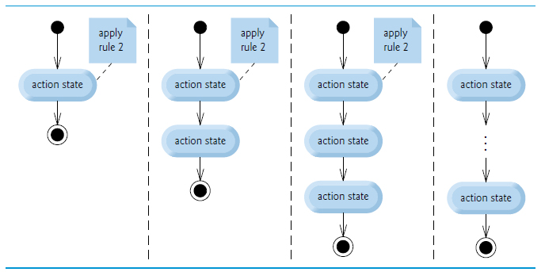
Figure 6.24 Repeatedly Applying the Stacking Rule (Rule 2) of Figure 6.22 to the Simplest Activity Diagram

Slide 101
6.12 Structured-Programming Summary (4 of 5)
Rule 3 is called the nesting rule.
Repeatedly applying rule 3 to the simplest activity diagram results in an activity diagram with neatly nested control statements.

Slide 102
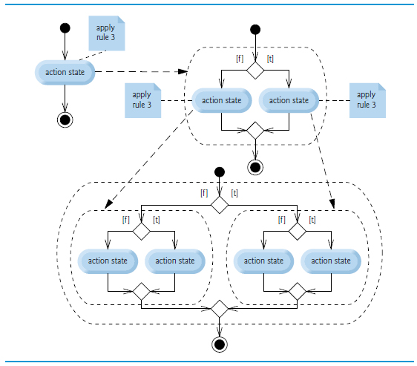
Figure 6.25 Repeatedly Applying Rule 3 of Figure 6.22 to the Simplest Activity Diagram

Slide 103
6.12 Structured-Programming Summary (5 of 5)
Rule 4 generates larger, more involved and more deeply nested statements.
If the rules are followed, an “unstructured” activity diagram (like the one in Figure 6.26) cannot be created.

Slide 104
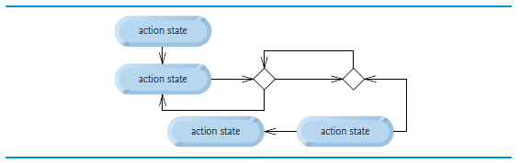
Figure 6.26 “Unstructured” Activity Diagram

Slide 105

Copyright

